Slide 1


Determination of the Optimum Catalyst Loading in Electrochemical-based Ethanol Gas Sensors
Siamak Farhad
July 24, 2013

Slide 2
Types of Electrochemical Sensors
Potentiometric
OCP measurement: The open circuit potential (OCP) of the sensor is measured at zero current to determine the ethanol gas partial pressure.
Amperometric
The current is monitored with one of the following methods:
Voltammetry: A potential is applied to the electrode and the current response is measured. Most popular voltammetric methods are linear sweep voltammetry (LSV) and cyclic voltammetry (CV).
Galvanometric: The spontaneous external current between two electrodes is monitored. The amplitude of the current reflects the ethanol gas concentration.
Coulometric: The total number of transferred electrons is measured. This is an advantage when the magnitude of current is small.

Slide 3
Types of Electrochemical Sensors
Potentiometric
OCP measurement: The open circuit potential (OCP) of the sensor is measured at zero current to determine the ethanol gas partial pressure.
Amperometric
The current is monitored with one of the following methods:
Voltammetry: A potential is applied to the electrode and the current response is measured. Most popular voltammetric methods are linear sweep voltammetry (LSV) and cyclic voltammetry (CV).
Galvanometric: The spontaneous external current between two electrodes is monitored. The amplitude of the current reflects the ethanol gas concentration.
Coulometric: The total number of transferred electrons is measured. This is an advantage when the magnitude of current is small.

Slide 4
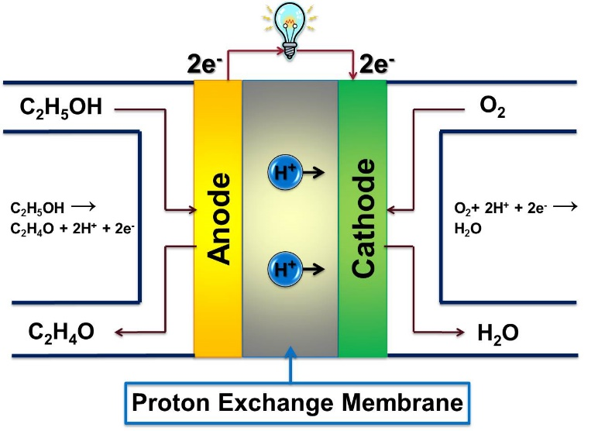

Task 1: Helping in Establishment of the Experimental Setup
Air control valve
Input air
Water Trap
Exit air
EtOH
DDI
Water
Mixture
Sensor
Simulator 1
Simulator 2
Water
Data Logger

Slide 5
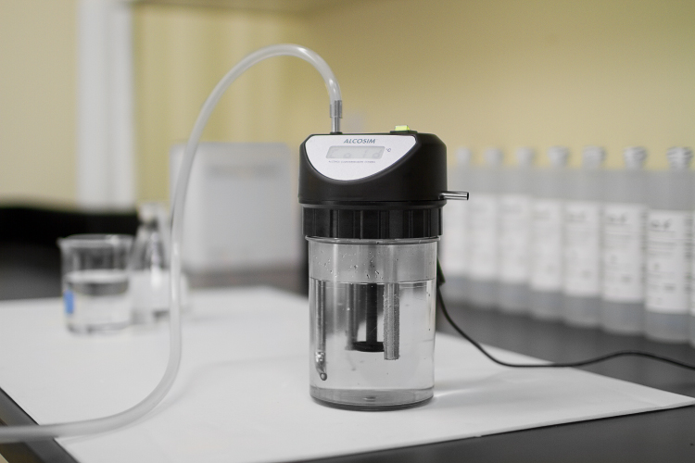
Task 2: Producing Referance Solution
Determination of the volume of liquid ethanol in 500 ml DDI water to simulate BACs of 0.01, 0.02, 0.03, 0.04, 0.05, 0.06, 0.07, 0.08, 0.1, 0.15, 0.2, 0.25, 0.3, 0.35, 0.4, 0.45, and 0.5 based on both
Thermodynamic calculations
Experiment

Slide 6
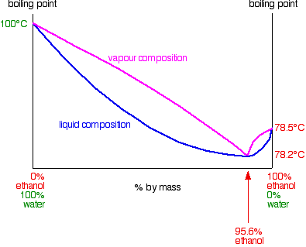


Ethanol Mole Fraction in Alcohol Reference Solution
Assumptions:
Vapour and liquid phases in the Breathalyzer Simulator are in equilibrium
The vapour phase is an ideal gas mixture
The liquid phase in a non-ideal mixture
Based on the modified Raoult's law:
P = 1 atm
$$p=p_{EtOH}^{∗}x_{EtOH}^{liquid}γ_{EtOH}+p_{H_{2}O}^{∗}x_{H_{2}O}^{liquid}γ_{H_{2}O}$$
$$p:total vapour pressure$$
$$p^{∗}:vapour pressure of pure EtOH or H_{2}O$$
$$x^{solution}:mole fraction ofEtOH or H_{2}O in the liquid phase$$
$$x^{solution}:mole fraction ofEtOH or H_{2}O in the liquid phase$$
$$γ:activity coefficienct$$

Slide 7


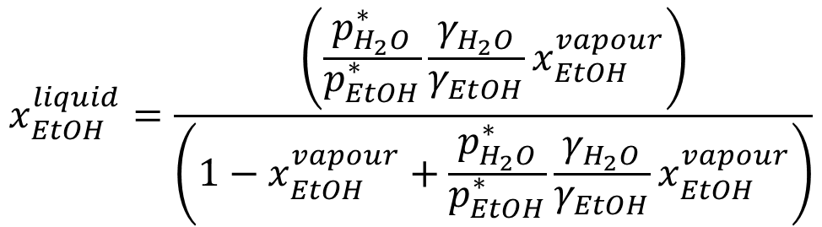
Ethanol Mole Fraction in Alcohol Reference Solution (Cont’d)
Based on the Dalton’s law:
We have:
Thus,
Finally,
$$p_{EtOH}^{Vapour}=x_{EtOH}^{vapour} p$$
$$p_{EtOH}^{Vapour}=p_{EtOH}^{∗}x_{EtOH}^{liquid}γ_{EtOH}$$
$p_{EtOH}^{∗}x_{EtOH}^{liquid}γ_{EtOH}=x_{EtOH}^{vapour} p$= $x_{EtOH}^{vapour}\left(p_{EtOH}^{∗}x_{EtOH}^{liquid}γ_{EtOH}+p_{H_{2}O}^{∗}x_{H_{2}O}^{liquid}γ_{H_{2}O}\right)$
$$x_{EtOH}^{liquid}=\frac{\left(\frac{p_{H_{2}O}^{∗}}{p_{EtOH}^{∗}}\frac{γ_{H_{2}O}}{γ_{EtOH}}x_{EtOH}^{vapour}\right)}{\left(1−x_{EtOH}^{vapour}+\frac{p_{H_{2}O}^{∗}}{p_{EtOH}^{∗}}\frac{γ_{H_{2}O}}{γ_{EtOH}}x_{EtOH}^{vapour}\right)}$$

Slide 8
Ethanol Mole Fraction in Alcohol Reference Solution (Cont’d)
Ethanol and water vapour pressures are estimated from the Antoine’s equation:
$$p_{EtOH}^{∗}(mmHg)={10}^{\left(8.20417− \frac{1642.89}{230.3+T (°C)}\right)} −57°C<T<80°C$$
$$p_{H_{2}O}^{∗}\left(mmHg\right)={10}^{\left(8.07131− \frac{1730.63}{233.426+T \left(°C\right)}\right)} 1°C<T<100°C$$

Slide 9
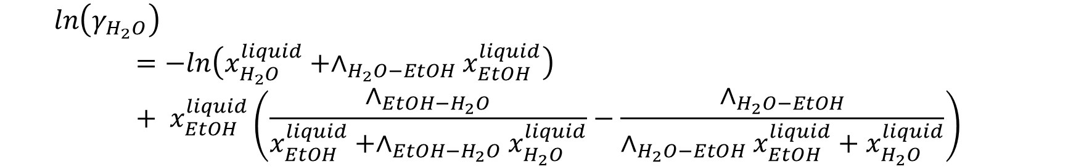
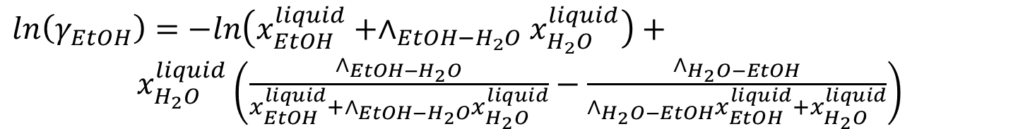
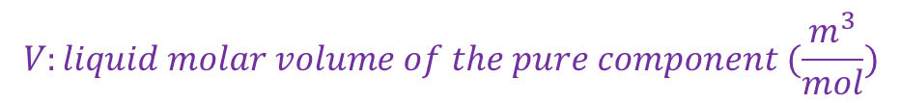
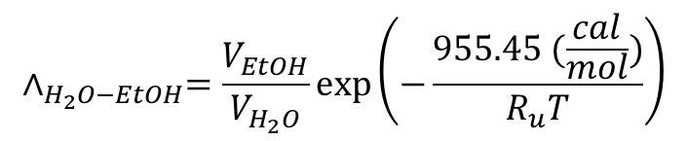
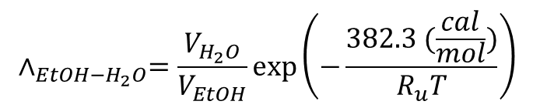
Ethanol Mole Fraction in Alcohol Reference Solution (Cont’d)
Activity coefficients are estimated using Wilson’s model:
$ln\left(γ_{EtOH}\right)=−ln\left(x_{EtOH}^{liquid}+∧_{EtOH−H_{2}O}x_{H_{2}O}^{liquid}\right)+$ $x_{H_{2}O}^{liquid}\left(\frac{∧_{EtOH−H_{2}O}}{x_{EtOH}^{liquid}+∧_{EtOH−H_{2}O}x_{H_{2}O}^{liquid}}−\frac{∧_{H_{2}O−EtOH}}{{∧_{H_{2}O−EtOH}x}_{EtOH}^{liquid}+x_{H_{2}O}^{liquid}}\right)$
$$ln\left(γ_{H_{2}O}\right)=−ln\left(x_{H_{2}O}^{liquid}+∧_{H_{2}O−EtOH}x_{EtOH}^{liquid}\right)+ x_{EtOH}^{liquid}\left(\frac{∧_{EtOH−H_{2}O}}{x_{EtOH}^{liquid}+∧_{EtOH−H_{2}O}x_{H_{2}O}^{liquid}}−\frac{∧_{H_{2}O−EtOH}}{{∧_{H_{2}O−EtOH}x}_{EtOH}^{liquid}+x_{H_{2}O}^{liquid}}\right)$$
$$∧_{EtOH−H_{2}O}=\frac{V_{H_{2}O}}{V_{EtOH}}exp\left(−\frac{382.3 (\frac{cal}{mol})}{R_{u}T}\right)$$
$$∧_{H_{2}O−EtOH}=\frac{V_{EtOH}}{V_{H_{2}O}}exp\left(−\frac{955.45 (\frac{cal}{mol})}{R_{u}T}\right)$$
$$V:liquid molar volume of the pure component (\frac{m^{3}}{mol})$$

Slide 10
Ethanol Mole Fraction in Alcohol Reference Solution (Cont’d)
Which equation (e.g. Van Laar, NRTL, UNIQUAC, Margules, Wilson, etc) is more accurate to predict the activity coefficient for a dilute mixture of ethanol in water?
The method used in previous slides is a sample. Use/establish another method to calculate the volume of liquid ethanol in water if you think that another model is more accurate.

Slide 11
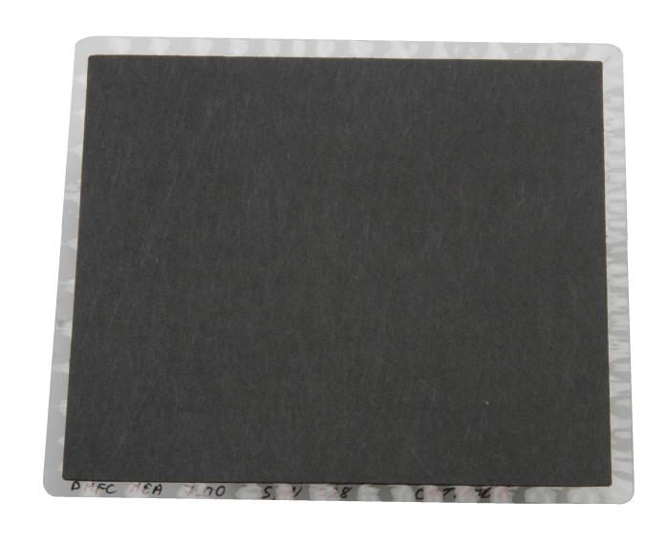
Task 3: Sensor Fabrication & Testing
Repeatable sensor/MEA fabrication and Testing.
Procedures for Sensor/MEA Fabrication:
Nafion membrane purification
Preparation of catalyst ink & coating on gas diffusion layer (GDL)
Hot-pressing

Slide 12
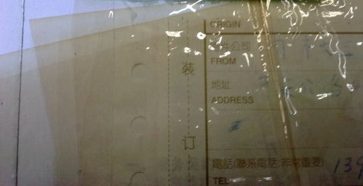
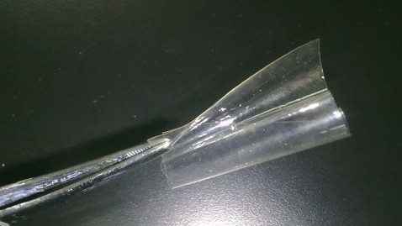
Nafion Membrane Purification
The membrane is immersed in DDI water for 24h and subsequently boiled for 1h.
To remove organic and inorganic contaminants, the membrane is boiled in 5-vol% H₂O₂ solution for 1h and subsequently rinsed with DDI water for 3 times and boil in DDI water for 1h.
The membrane is converted into the acid form by boiling it in 1M (mol/L) H₂SO₄ solution for 1h, followed by rinsing with DDI water for 3 times and boiling in DDI water for 1h.
After completing the purification procedure, the membrane should be stored in DDI water at room temperature prior to use.

Slide 13
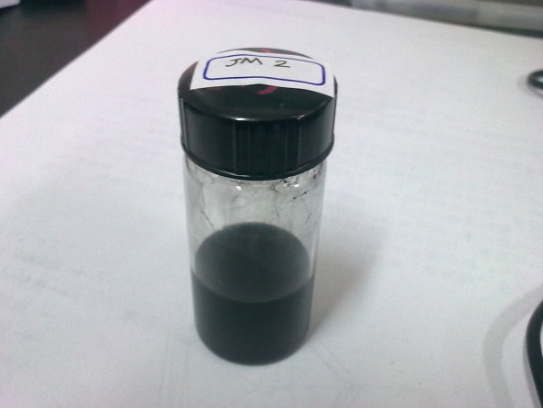
Preparation of Catalyst Ink & Coating on GDL
Use Pt/C (28.2 wt% Pt) as the catalyst and Nafion (5 wt%) as the ionomer.
The ratio of the catalyst and ionomer is 3:1 (wt/wt). Indeed, the fraction of catalyst is 0.75 and ionomer is 0.25.
Weigh the Pt/C and Nafion for achieving x (mg/cm²) Pt loading on y cm² active area of MEA.
Adding the 2-propanol as dispersing agent (as a sample, add 1 mL 2-propanol for each 6 mg of Pt/C).
Sonicating for 2h

Slide 14
Required Formulas for Preparation of Catalyst Ink
Active area of MEA
Theoretical loading of Pt
Weight fraction of Nafion in slurry
Efficiency of spraying
Weight ratio of Pt in Pt/C
Weight ratio of Nafion in the solution
Weight fraction of Pt/C in slurry

Slide 15
Catalyst Coating
Weigh the dry GDL (m₀) (put it in oven at 60°C for 1h for drying) Wash the airbrush with ethanol and sonicate for 1h
Regulate the gas flow rate and start spraying
Clean the airbrush after you finish the coating
Weigh the coated dry GDL (m₁) after coating (put it in oven at 60°C for 1h for drying)
Calculate the Efficiency of spraying (η) and catalyst loading (q_{Pt}).

Slide 16
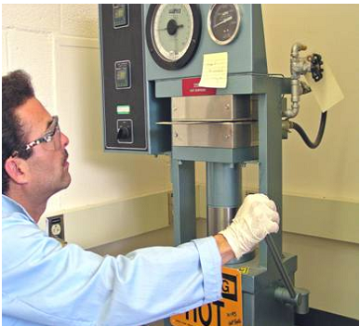
Hot-pressing
Add 2 and 3 drops of 5% Nafion ionomer solution on the coated surface of both cathode and anode and dry it at ambient temperature.
Cut the Nafion a little larger than the electrodes size to prevent shot circuit.
Sandwich the Nafion membrane between two electrodes.
Hot-press at 80ºC (130°C) and 20 (100) MPa for 3 min.

Slide 17
Task 4: Testing & Final Results
4.1 Experiment design to minimize the number of tests.
4.2 Determination of the effect of electrode catalyst loading on the sensor response time at 7 different BACs, based on the following table.
4.3 Selection of one of the above sensors and conducting the performance tests at various environmental conditions listed in the following table.
 | Catalyst Loading
Anode (mg/cm²) / Cathode (mg/cm²) | 0.2 / 0.2 | 0.3 / 0.2 | 0.4 / 0.2 | 0.5 / 0.2 | 0.6 / 0.2
Anode (mg/cm²) / Cathode (mg/cm²) | 0.2 / 0.3 | 0.3 / 0.3 | 0.4 / 0.3 | 0.5 / 0.3 | 0.6 / 0.3
Anode (mg/cm²) / Cathode (mg/cm²) | 0.2 / 0.4 | 0.3 / 0.4 | 0.4 / 0.4 | 0.5 / 0.4 | 0.6 / 0.4
Anode (mg/cm²) / Cathode (mg/cm²) | 0.2 / 0.5 | 0.3 / 0.5 | 0.4 / 0.5 | 0.5 / 0.5 | 0.6 / 0.5
Anode (mg/cm²) / Cathode (mg/cm²) | 0.2 / 0.6 | 0.3 / 0.6 | 0.4 / 0.6 | 0.5 / 0.6 | 0.6 / 0.6
 | Environmental Effect
Temp (°C) / relative humidity (%) | -10 / 10% | 0 / 10% | 10 / 10% | 20 / 10% | 30 / 10% | 40 / 10%
Temp (°C) / relative humidity (%) | -10 / 30% | 0 / 30% | 10 / 30% | 20 / 30% | 30 / 30% | 40 / 30%
Temp (°C) / relative humidity (%) | -10 / 50% | 0 / 50% | 10 / 50% | 20 / 50% | 30 / 50% | 40 / 50%
Temp (°C) / relative humidity (%) | -10 / 70% | 0 / 70% | 10 / 70% | 20 / 70% | 30 / 70% | 40 / 70%
Temp (°C) / relative humidity (%) | -10 / 90% | 0 / 90% | 10 / 90% | 20 / 90% | 30 / 90% | 40 / 90%

Slide 18
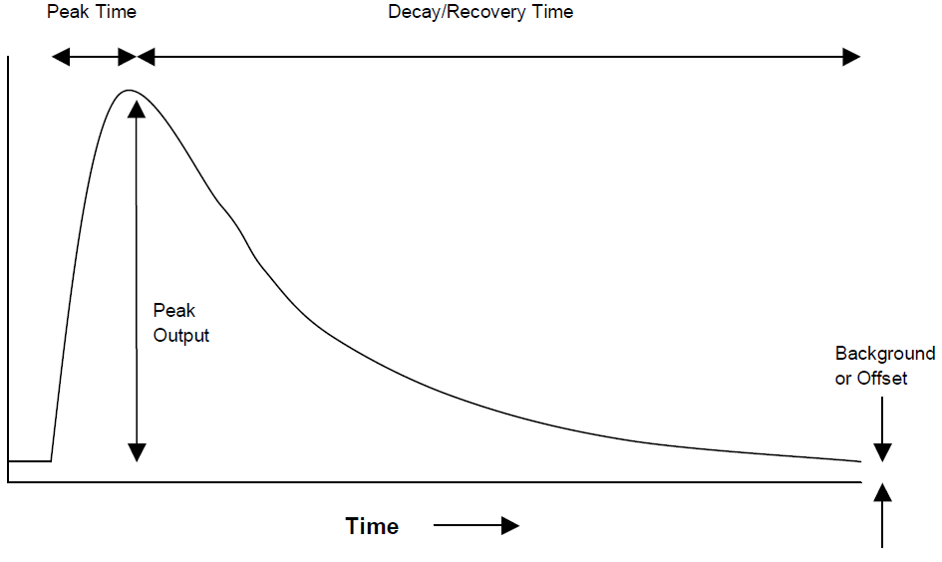
Results Expected
From the experiment in section 4.2:
Plot the peak current (or voltage) versus BAC for all samples tested.
Plot the area below the current-time graph versus BAC for all samples.
Plot the peak time and total time (peak time + recovery time) versus BAC for all samples.
From the experiments in section 4.3:
Plot the peak current (or voltage) versus temperature at various humidities for a specific BAC.
Study about the sensitivity and linearity of the sensor selected in section 4.2.

Slide 19
Some Definitions
Sensitivity
Slope of the signal-versus-concentration graph.
Selectivity
Ratio of the signal for the target analyte to another or several other electro-active species that may be simultaneously present in the sample.
Accuracy
Refers to the “true” value and how well any given sensor or method provides the true value for the analysis.
Precision
Repeatability of a given measurement.
Linearity
The range that the response-versus-concentration graph is linear.
Stability
The ability to retain the original response characteristics over long time periods and under changing environmental conditions.

Slide 20
Useful Unit Conversions
0.01 BAC = 0.04762 mg_{EtOH}/L_{Breath} = 0.001034 mol_{EtOH}/m³_{Breath}
Ethanol concentration in human breath: C_{EtOH} (mol/m³) = 0.1034 BAC
Mole fraction of ethanol in human breath:
$x_{EtOH}\left(ppm\right)={10}^{6}\frac{R_{u}T}{p}×0.1034×BAC$= $2606×BAC$ @ (34°C and 1 atm)

